Slide 1

AMPY LOGI – Building the operating system for Relocation & Logistics Services.
Subtitle – Technology driven B2B, B2C & B2V Logistics Network.
Founder- Satya Ranjan Patnaik
Location Access – PAN India
Business Contact - 9777013918
Website - (Coming Soon)

Slide 2
About AMPY LOGI
* Who We Are :-
👉Ampy Logi is a logistics and relocation platform connecting:-
Businesses
Households
Logistics Vendors
through a managed service network.
* Vision -
To become India's most trusted technology-enabled relocation and logistics ecosystem.
* Mission –
Simplify logistics execution through vendor aggregation, process standardization, technology, pricing feasibility, on-time delivery and operational transparency.

Slide 3
Industry Problem -
👉Problems in Current Logistics Ecosystem
* For Customers
No price transparency
No tracking visibility
Multiple vendor dependency
Poor service quality
* For Businesses
Vendor management complexity
Lack of accountability
Manual coordination
* For Vendors
Inconsistent order flow
Delayed payments
No technology support
Poor customer acquisition

Slide 4
Our Solution
✅ Ampy Logi Platform –
👉A single ecosystem connecting:-
* B2B
Corporate logistics requirements
* B2C
Household relocation requirements
* B2V
Vendor acquisition and order management
* What We Solve
Discovery
Quotation
Vendor allocation
Tracking
Execution
Support

Slide 5
Business Model
👉Revenue Streams-
* B2B Revenue
Corporate relocation
Employee shifting
Business logistics
* B2C Revenue
Household moving
Packing services
Transportation
* B2V Revenue
Vendor onboarding
Technology enablement
Lead generation
Future subscription model

Slide 6
Current Traction
* Current Progress-
👉Mention latest figures:-
Orders completed – 500+ Counting
Orders in progress – 25+ Counting
Vendor network size – 50+ Counting
Cities covered – 7+ Counting
* Validation Achieved-
Live paying customers – 50+ Counting
Operational execution completed – 500+ Counting
Vendor network activated – 30+ Counting
Repeat inquiries received – 20+ Counting

Slide 7
Customer Journey
👉B2C Flow –
Lead Generated
↓
Requirement Collection
↓
Quotation
↓
Vendor Allocation
↓
Execution
↓
Customer Support
↓
Closure

Slide 8
B2B Services
* Corporate Services -
Employee Relocation
Office Relocation
Logistics Coordination
Vendor Management
Documentation Support
* Value Proposition -
Single point accountability.

Slide 9
B2B Services – Sub Categories
👉Industries Currently Served
✅ Household Relocation & Packers Movers
✅ Electronics & Appliance Movement
✅ FMCG Distribution
✅ Construction & Building Materials
✅ Textile & Apparel Logistics
✅ E-commerce & D2C Deliveries
✅ Pharma & Medical Supplies
✅ Batteries, Solar Panels, Inverters & Energy Equipment
👉Industries Being Expanded
🔹 Corporate & Office Relocation
🔹 MSME & Manufacturing Goods
🔹 Spare Parts & Auto Components
🔹 Agricultural Supplies
🔹 Cold Chain & Perishables
🔹 Event & Exhibition Logistics
🔹 Documents & Light Courier Services
🔹 Nursery Shipments
🔹 Gym & Fitness Equipment
🔹 Cloud Kitchen Supplies
🔹 Salon & Spa Equipment
👉Long-Term Opportunity Segments
🔸 Alcoholic Beverages Logistics
🔸 Defense Equipment Logistics
🔸 Hazardous Goods & Special Cargo
🔸 Industrial Chemicals
🔸 Utility & Service Equipment Transportation
👉Order Booking - Businesses can initiate a service request directly through: -
🔗Order Inquiry Form - (https://forms.gle/yUbdNtFyVDPhoYuD9)

Slide 10
B2C Services
* Household Services -
Local Shifting
Intercity Relocation
Packing Services
Loading & Unloading
Vehicle Transportation
* Benefits -
Verified Vendors
Transparent Pricing
Managed Execution
👉Order Booking - Customers can initiate a service request directly through: -
🔗Order Inquiry Form - 🔗(https://forms.gle/yUbdNtFyVDPhoYuD9)

Slide 11
B2V Services
👉Vendor Network Program -
* For Packers & Movers -
New Orders
Business Growth
Technology Support
* For Drivers -
Consistent Trips
Better Utilization
* For Small Logistics Operators -
Access to Customers
Operational Support
* Future Vision -
Become India's largest vendor aggregation platform for relocation services.
👉Vendor Registration - Interested logistics partners/ vendors can join Ampy Logi through our vendor onboarding process.
🔗 Vendor Onboarding Form 🔗[https://forms.gle/Hn2rFfxPJscEMqFbA]

Slide 12
Operational Process
👉Order Lifecycle -
Lead
↓
Verification
↓
Quotation
↓
Vendor Selection
↓
Execution Monitoring
↓
Issue Resolution
↓
Completion

Slide 13
Vendor Network Strength
* Vendor Ecosystem -
Current Categories:
Packers & Movers
Transporters
Drivers
Labour Partners
* Selection Criteria -
Verification
Experience
Service Quality
Reliability

Slide 14
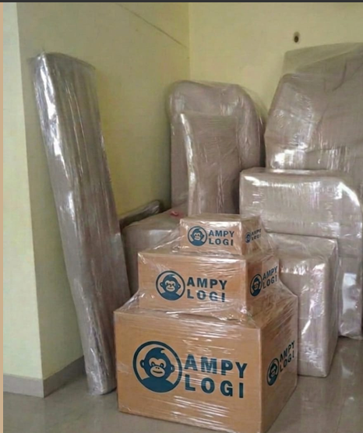
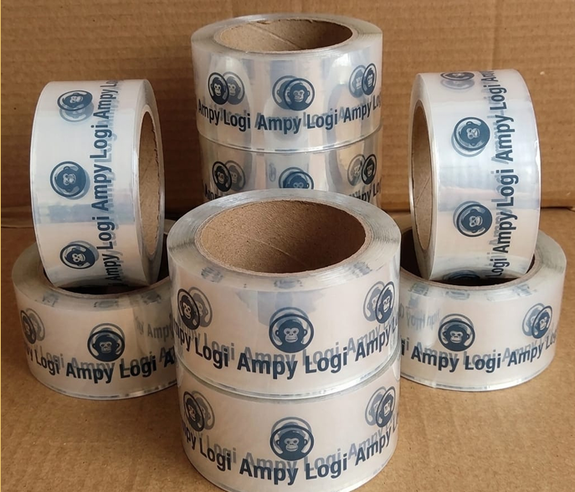
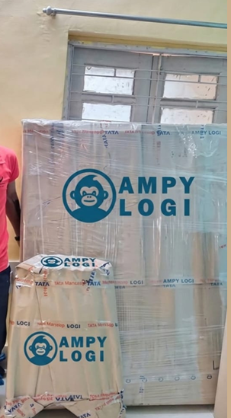
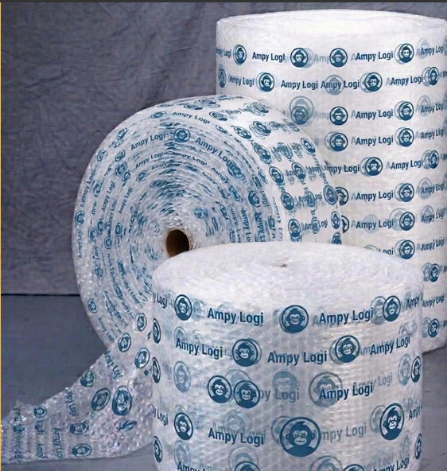
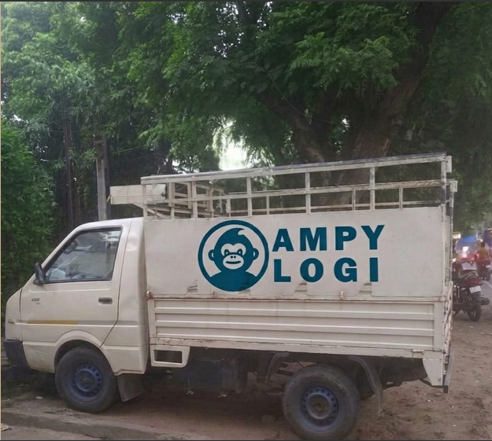
Merchandise/D2C Execution Slide
👉Ampy Logi has supported movement and distribution activities involving:-
Branded Merchandise
Promotional Products
Customer Deliveries
Packaging Support
D2C Product Dispatches

Slide 15
Technology Roadmap
* Current -
Google Forms
Dashboards
Order Trackers
* Phase 2 -
Website
CRM
Lead Management
* Phase 3 -
Vendor Portal
Customer Dashboard
Real-Time Tracking
* Phase 4 -
Mobile Application

Slide 16
Why Ampy Logi ?
👉Differentiators
✅ B2B + B2C + B2V
✅ Asset-Light Model
✅ Vendor Network Driven
✅ Technology Focused
✅ Scalable Operations
✅ PAN-India Expansion Potential

Slide 17
Market Opportunity
👉India Relocation Market –
* Large fragmented industry with: -
Thousands of vendors
Low digitization
Poor standardization
* Opportunity -
To Create a trusted logistics operating layer.

Slide 18
Customer Validation & Live Testimonials
👉What Our Customers Say -
Over the past executions, customers have appreciated:
✅ Timely Delivery
✅ Transparent Communication
✅ Reliable Vendor Coordination
✅ Safe Handling of Goods
✅ Smooth End-to-End Execution
👉Live Customer Feedback 1 – FMCG Category
(https://www.linkedin.com/posts/satya-ranjan-patnaik-725477134_learningandexecution-fmcg-supplychain-activity-7452200173717594112--NHq?utm_source=share&utm_medium=member_android&rcm=ACoAACDRGk0BNWsJm1CeeKZylv0vvLohLr77TMU)
👉Live Customer Feedback 2– MANUFACTURING Category
(https://www.linkedin.com/posts/satya-ranjan-patnaik-725477134_learningandexecution-manufacturinglogistics-activity-7452593949778808832--qiQ?utm_source=share&utm_medium=member_android&rcm=ACoAACDRGk0BNWsJm1CeeKZylv0vvLohLr77TMU)
👉Live Customer Feedback 2– PACKERS & MOVERS Category
(https://www.linkedin.com/posts/satya-ranjan-patnaik-725477134_learningandexecution-logistics-supplychain-activity-7453034569470988288-A1f5?utm_source=share&utm_medium=member_android&rcm=ACoAACDRGk0BNWsJm1CeeKZylv0vvLohLr77TMU)

Slide 19
FAQs
Q1) How are logistics charges calculated?
Answer: Based on distance, vehicle type, manpower requirement, packaging requirement, and nature of goods.
Q2) Are vendors verified before onboarding?
Answer: Yes. Vendors undergo a screening and onboarding process before becoming part of the Ampy Logi network.
Q3) Do you provide B2B and B2C services?
Answer: Yes. Ampy Logi serves both businesses and individual customers.
Q4) Can I request a customized quotation?
Answer: Yes. Every logistics requirement is evaluated individually.
Q5) How can vendors join Ampy Logi?
Answer: Through the Vendor Onboarding Form and verification process.
Q6) Which industries do you currently support?
Answer: Household relocation, FMCG, construction materials, e-commerce, electronics, pharma, textile, energy equipment and more.
Q7) How can customers place orders?
Answer: Through the Order Inquiry Form, direct call, email, or WhatsApp.

Slide 20
Current Challenges
* Challenges -
Technology Development
Working Capital
Vendor Expansion
Brand Building
* Immediate Focus -
Website Launch
Process Automation
Customer Acquisition

Slide 21
Future Roadmap
👉Next 6 Months
Website Launch
CRM Deployment
Vendor Expansion
B2B Acquisition
Process Standardization
👉Next 2 Years
Multi-city Presence
Vendor Marketplace
Technology Platform

Slide 22
Website Governance & Trust Framework
Privacy Policy
Terms & Conditions
Cancellation & Refund Policy
Data Security & Customer Privacy
Referral Program (Future)

Slide 23
Closing
Thank You
Ampy Logi : Building Trust Through Logistics.
Founder : Satya Ranjan Patnaik
Contact: Phone – 9777013918 (Business) , 8763993918 (Personal) Email – ampy.logi21@gmail.com (Business) , Satyaniks1@gmail.com (Personal) LinkedIn - https://www.linkedin.com/company/ampy-logi (Business), https://www.linkedin.com/in/satya-ranjan-patnaik-725477134 (Personal)

